Slide 2
"Data are not just numbers,
they are numbers with a context."
- George Cobb and David Moore (1997)

Slide 3
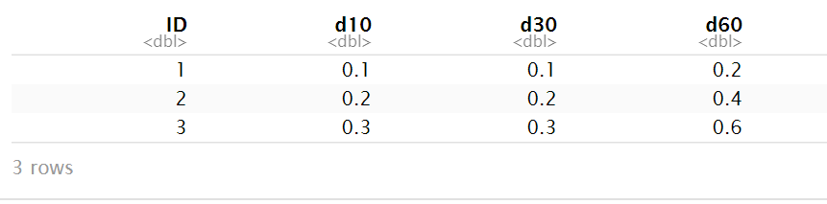
Quiz
What are the variables in this data set?
myData

Slide 4
Quiz
What are the variables in this data set?
myData
Dissolution at time x
(minutes)

Slide 5

Quiz
What are the variables in this data set?
myData
…so then “time”
is also a variable

Slide 6

Tidy data
country | year | cases | pop
Afghanistan | 1999 | 745 | 19987071
Afghanistan | 2000 | 2666 | 20595360
Brazil | 1999 | 37737 | 172006362
Brazil | 2000 | 80488 | 174504898
China | 1999 | 212258 | 1272915272
China | 2000 | 213766 | 1280428583
A data set is tidy if:
Each variable is in its own column
Each case is in its own row
Each value is in its own cell

Slide 7
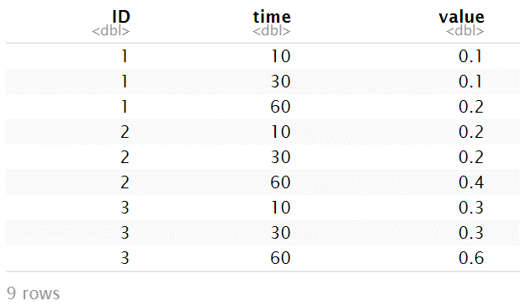

Quiz
What are the variables in this data set?
myNewData

Slide 8
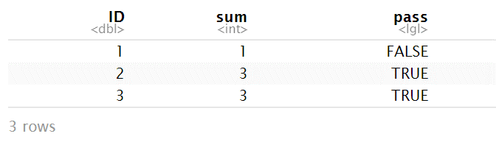
So now you can compute on `time` and `value`:
myNewData %>%
mutate(comparison = case_when(time==10 ~ value>=0.1,
time==30 ~ value>=0.2,
time==60 ~ value>=0.3,
TRUE ~ NA)) %>%
group_by(ID) %>%
summarise(sum = sum(comparison)) %>%
mutate(pass = sum==3)

Slide 9
"All happy families are alike; each unhappy family is unhappy in its own way."
- Leo Tolstoy (in Anna Karenina)

Slide 10
"Tidy data sets are all alike; but every messy data set is messy in its own way."
- Hadley Wickham

Slide 11
"Data comes in many formats, but R prefers just one: tidy data. "
- Garrett Grolemund

Slide 12
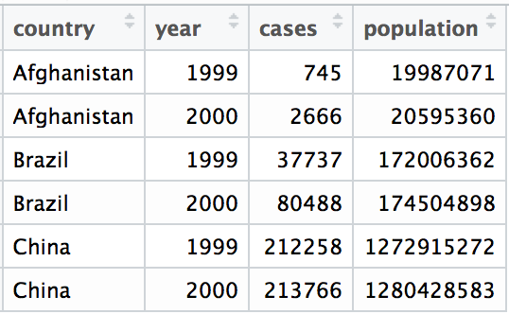
Tidy data
A data set is tidy iff:
Each variable is in its own column
Each case is in its own row
Each value is in its own cell

Slide 13
Import data into software
Collect
Data
Tidy data into useable form
Design Experiment
Explore or Test
Form Hypothesis
Transform the data. Do feature engineering.
Deploy app or publish paper
Write code to apply a modeling algorithm.
Build app or write paper
Visualize the data and/or results
Communicate Results

Slide 14
Tidy data into useable form
Import data into software
Munge data
Collect
Data
Explore or Test
Design Experiment
Transform the data. Do feature engineering.
Form Hypothesis
Munge data
Deploy app or publish paper
Write code to apply a modeling algorithm.
Build app or write paper
Munge data
Communicate Results
Visualize the data and/or results
Munge data

Slide 15

tidyr

Slide 16

tidyr
A package that reshapes the layout of tabular data.
CC BY-SA RStudio

Slide 17
pivot_longer( )

Slide 18
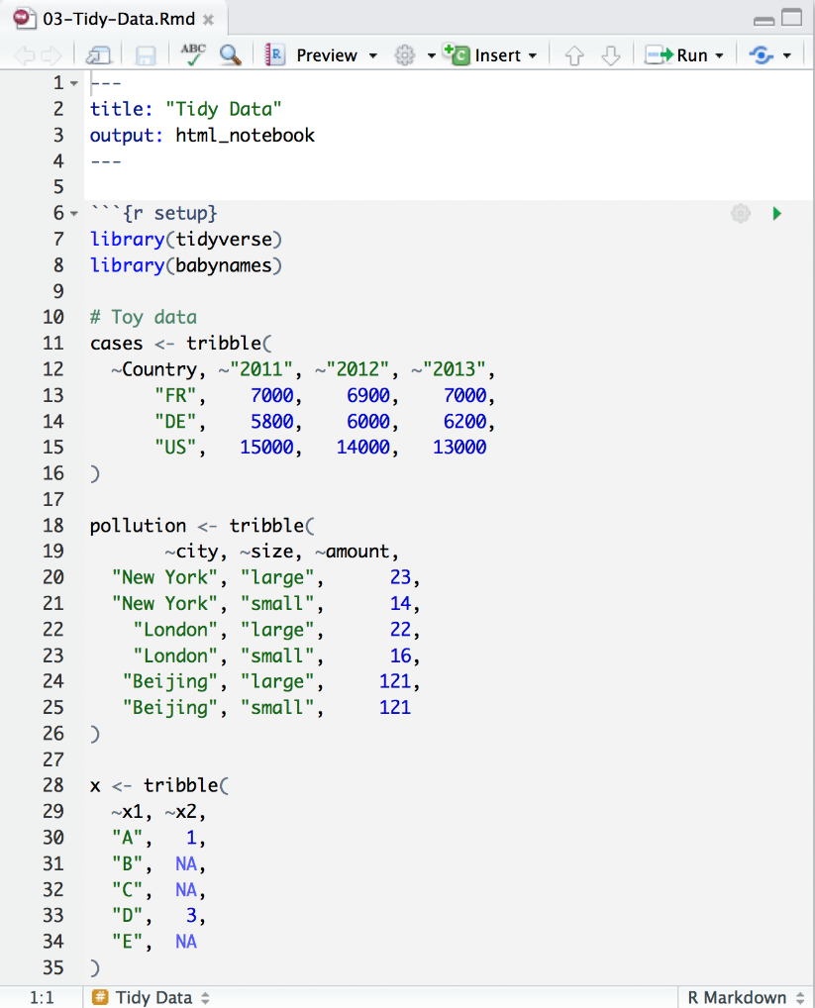
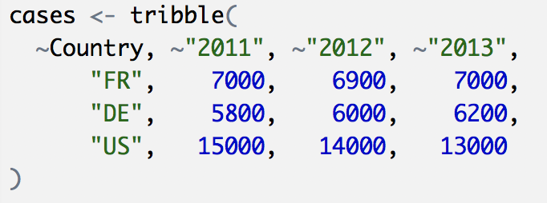
Toy data
CC BY-SA RStudio

Slide 19
Quiz
What are the variables in cases?
Country | 2011 | 2012 | 2013
FR | 7000 | 6900 | 7000
DE | 5800 | 6000 | 6200
US | 15000 | 14000 | 13000

Slide 20
Quiz
What are the variables in cases?
Country | 2011 | 2012 | 2013
FR | 7000 | 6900 | 7000
DE | 5800 | 6000 | 6200
US | 15000 | 14000 | 13000
Country
Year
Count

Slide 21
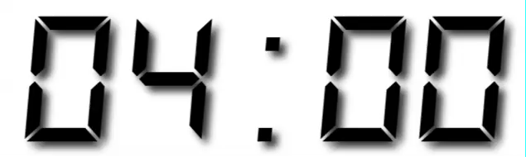
Your Turn 1
On a sheet of paper, draw how the cases data set would look if it had the same values grouped into three columns: country, year, n
Country | 2011 | 2012 | 2013
FR | 7000 | 6900 | 7000
DE | 5800 | 6000 | 6200
US | 15000 | 14000 | 13000

Slide 22
Country | 2011 | 2012 | 2013
FR | 7000 | 6900 | 7000
DE | 5800 | 6000 | 6200
US | 15000 | 14000 | 13000
CC BY-SA RStudio

Slide 23
Country | 2011 | 2012 | 2013
FR | 7000 | 6900 | 7000
DE | 5800 | 6000 | 6200
US | 15000 | 14000 | 13000
Country | Year | n
FR | 2011 | 7000
DE | 2011 | 5800
US | 2011 | 15000
FR | 2012 | 6900
DE | 2012 | 6000
US | 2012 | 14000
FR | 2013 | 7000
DE | 2013 | 6200
US | 2013 | 13000
CC BY-SA RStudio

Slide 24
Country | 2011 | 2012 | 2013
FR | 7000 | 6900 | 7000
DE | 5800 | 6000 | 6200
US | 15000 | 14000 | 13000
Country | Year | n
FR | 2011 | 7000
DE | 2011 | 5800
US | 2011 | 15000
FR | 2012 | 6900
DE | 2012 | 6000
US | 2012 | 14000
FR | 2013 | 7000
DE | 2013 | 6200
US | 2013 | 13000
CC BY-SA RStudio

Slide 25
Country | 2011 | 2012 | 2013
FR | 7000 | 6900 | 7000
DE | 5800 | 6000 | 6200
US | 15000 | 14000 | 13000
Country | Year | n
FR | 2011 | 7000
DE | 2011 | 5800
US | 2011 | 15000
FR | 2012 | 6900
DE | 2012 | 6000
US | 2012 | 14000
FR | 2013 | 7000
DE | 2013 | 6200
US | 2013 | 13000
CC BY-SA RStudio

Slide 26
Country | 2011 | 2012 | 2013
FR | 7000 | 6900 | 7000
DE | 5800 | 6000 | 6200
US | 15000 | 14000 | 13000
Country | Year | n
FR | 2011 | 7000
DE | 2011 | 5800
US | 2011 | 15000
FR | 2012 | 6900
DE | 2012 | 6000
US | 2012 | 14000
FR | 2013 | 7000
DE | 2013 | 6200
US | 2013 | 13000
CC BY-SA RStudio

Slide 27
Country | 2011 | 2012 | 2013
FR | 7000 | 6900 | 7000
DE | 5800 | 6000 | 6200
US | 15000 | 14000 | 13000
Country | Year | n
FR | 2011 | 7000
DE | 2011 | 5800
US | 2011 | 15000
FR | 2012 | 6900
DE | 2012 | 6000
US | 2012 | 14000
FR | 2013 | 7000
DE | 2013 | 6200
US | 2013 | 13000
CC BY-SA RStudio

Slide 28
Country | 2011 | 2012 | 2013
FR | 7000 | 6900 | 7000
DE | 5800 | 6000 | 6200
US | 15000 | 14000 | 13000
Country | Year | n
FR | 2011 | 7000
DE | 2011 | 5800
US | 2011 | 15000
FR | 2012 | 6900
DE | 2012 | 6000
US | 2012 | 14000
FR | 2013 | 7000
DE | 2013 | 6200
US | 2013 | 13000
CC BY-SA RStudio

Slide 29
Country | 2011 | 2012 | 2013
FR | 7000 | 6900 | 7000
DE | 5800 | 6000 | 6200
US | 15000 | 14000 | 13000
Country | Year | n
FR | 2011 | 7000
DE | 2011 | 5800
US | 2011 | 15000
FR | 2012 | 6900
DE | 2012 | 6000
US | 2012 | 14000
FR | 2013 | 7000
DE | 2013 | 6200
US | 2013 | 13000
CC BY-SA RStudio

Slide 30
Country | 2011 | 2012 | 2013
FR | 7000 | 6900 | 7000
DE | 5800 | 6000 | 6200
US | 15000 | 14000 | 13000
Country | Year | n
FR | 2011 | 7000
DE | 2011 | 5800
US | 2011 | 15000
FR | 2012 | 6900
DE | 2012 | 6000
US | 2012 | 14000
FR | 2013 | 7000
DE | 2013 | 6200
US | 2013 | 13000
CC BY-SA RStudio

Slide 31
Country | 2011 | 2012 | 2013
FR | 7000 | 6900 | 7000
DE | 5800 | 6000 | 6200
US | 15000 | 14000 | 13000
Country | Year | n
FR | 2011 | 7000
DE | 2011 | 5800
US | 2011 | 15000
FR | 2012 | 6900
DE | 2012 | 6000
US | 2012 | 14000
FR | 2013 | 7000
DE | 2013 | 6200
US | 2013 | 13000
CC BY-SA RStudio

Slide 32
Country | 2011 | 2012 | 2013
FR | 7000 | 6900 | 7000
DE | 5800 | 6000 | 6200
US | 15000 | 14000 | 13000
Country | Year | n
FR | 2011 | 7000
DE | 2011 | 5800
US | 2011 | 15000
FR | 2012 | 6900
DE | 2012 | 6000
US | 2012 | 14000
FR | 2013 | 7000
DE | 2013 | 6200
US | 2013 | 13000
CC BY-SA RStudio

Slide 33
Country | 2011 | 2012 | 2013
FR | 7000 | 6900 | 7000
DE | 5800 | 6000 | 6200
US | 15000 | 14000 | 13000
Country | Year | n
FR | 2011 | 7000
DE | 2011 | 5800
US | 2011 | 15000
FR | 2012 | 6900
DE | 2012 | 6000
US | 2012 | 14000
FR | 2013 | 7000
DE | 2013 | 6200
US | 2013 | 13000
CC BY-SA RStudio

Slide 34
Country | 2011 | 2012 | 2013
FR | 7000 | 6900 | 7000
DE | 5800 | 6000 | 6200
US | 15000 | 14000 | 13000
Country | Year | n
FR | 2011 | 7000
DE | 2011 | 5800
US | 2011 | 15000
FR | 2012 | 6900
DE | 2012 | 6000
US | 2012 | 14000
FR | 2013 | 7000
DE | 2013 | 6200
US | 2013 | 13000
pivot_longer
CC BY-SA RStudio

Slide 35
1
2
Country | 2011 | 2012 | 2013
FR | 7000 | 6900 | 7000
DE | 5800 | 6000 | 6200
US | 15000 | 14000 | 13000
Country | Year | n
FR | 2011 | 7000
DE | 2011 | 5800
US | 2011 | 15000
FR | 2012 | 6900
DE | 2012 | 6000
US | 2012 | 14000
FR | 2013 | 7000
DE | 2013 | 6200
US | 2013 | 13000
CC BY-SA RStudio

Slide 36
names_to (former column names)
Country | 2011 | 2012 | 2013
FR | 7000 | 6900 | 7000
DE | 5800 | 6000 | 6200
US | 15000 | 14000 | 13000
Country | Year | n
FR | 2011 | 7000
DE | 2011 | 5800
US | 2011 | 15000
FR | 2012 | 6900
DE | 2012 | 6000
US | 2012 | 14000
FR | 2013 | 7000
DE | 2013 | 6200
US | 2013 | 13000
CC BY-SA RStudio

Slide 37
values_to (former cells)
Country | 2011 | 2012 | 2013
FR | 7000 | 6900 | 7000
DE | 5800 | 6000 | 6200
US | 15000 | 14000 | 13000
Country | Year | n
FR | 2011 | 7000
DE | 2011 | 5800
US | 2011 | 15000
FR | 2012 | 6900
DE | 2012 | 6000
US | 2012 | 14000
FR | 2013 | 7000
DE | 2013 | 6200
US | 2013 | 13000
CC BY-SA RStudio

Slide 38
pivot_longer()
cases %>%
pivot_longer(cols, names_to= , values_to = )
Which columns to reshape?
New variable created from column names
New variable created from cell values

Slide 39
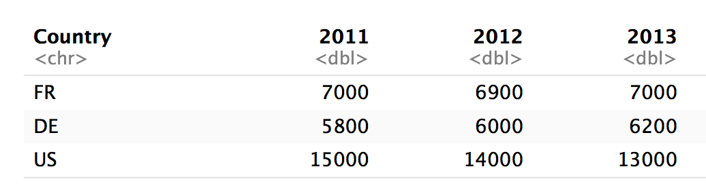
pivot_longer()
cases %>%
pivot_longer(cols = 2:4, names_to = "year", values_to = "count")
Column numbers
2
3
4

Slide 40
pivot_longer()
cases %>%
pivot_longer(cols=c(“2011”,”2012”,”2013”),
names_to = "year", values_to = "count")
Column names
2011
2012
2013

Slide 41
pivot_longer()
cases %>%
pivot_longer(-Country, names_to = "year", values_to = "count")
Everything except
Not Country
Not Country
Not Country

Slide 42
pivot_longer()
pivot_longer(cols = 2:4,
names_to = "year", values_to = "count")
pivot_longer(cols=c("2011", "2012", "2013"),
names_to = "year", values_to = "count")
pivot_longer(cols = starts_with("201"),
names_to = "year", values_to = "count")
pivot_longer(-Country,
names_to = "year", values_to = "count")

Slide 43
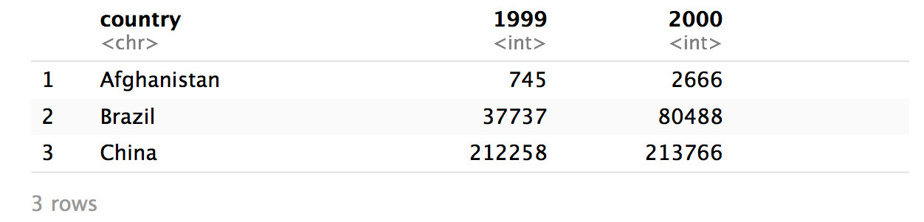
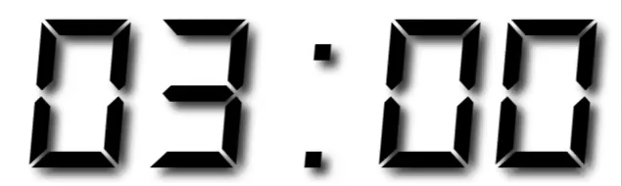
Your Turn 2
Use pivot_longer() to reorganize table4a into three columns: country, year, and cases.

Slide 44
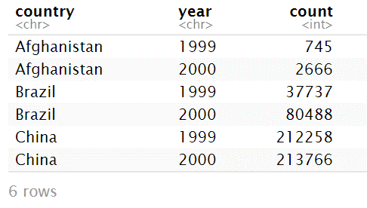
table4a %>%
pivot_longer(-country,
names_to = "year", values_to = "count")

Slide 45
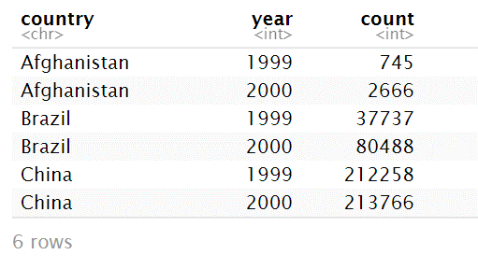
table4a %>%
pivot_longer(-country,
names_to = "year", names_ptypes = list(year = integer())
values_to = "count")

Slide 46
pivot_wider( )

Slide 47
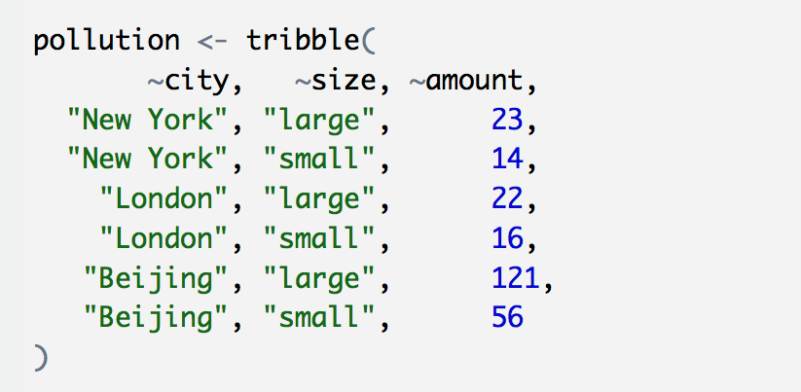
Toy data
CC BY-SA RStudio

Slide 48
Quiz
What are the variables in pollution?
city | particle size | amount (µg/m³)
New York | large | 23
New York | small | 14
London | large | 22
London | small | 16
Beijing | large | 121
Beijing | small | 56

Slide 49

Quiz
What are the variables in pollution?
city | particle size | amount (µg/m³)
New York | large | 23
New York | small | 14
London | large | 22
London | small | 16
Beijing | large | 121
Beijing | small | 56
City
Amount of large particulate
Amount of small particulate

Slide 50
Your Turn 3
On a sheet of paper, draw how this data set would look if it had the same values grouped into three columns: city, large, small
city | size | amount
New York | large | 23
New York | small | 14
London | large | 22
London | small | 16
Beijing | large | 121
Beijing | small | 56

Slide 51
city | size | amount
New York | large | 23
New York | small | 14
London | large | 22
London | small | 16
Beijing | large | 121
Beijing | small | 56
CC BY-SA RStudio

Slide 52
city | size | amount
New York | large | 23
New York | small | 14
London | large | 22
London | small | 16
Beijing | large | 121
Beijing | small | 56
city | large | small
New York | 23 | 14
London | 22 | 16
Beijing | 121 | 56
CC BY-SA RStudio

Slide 53
city | size | amount
New York | large | 23
New York | small | 14
London | large | 22
London | small | 16
Beijing | large | 121
Beijing | small | 56
city | large | small
New York | 23 | 14
London | 22 | 16
Beijing | 121 | 56
CC BY-SA RStudio

Slide 54
city | size | amount
New York | large | 23
New York | small | 14
London | large | 22
London | small | 16
Beijing | large | 121
Beijing | small | 56
city | large | small
New York | 23 | 14
London | 22 | 16
Beijing | 121 | 56
CC BY-SA RStudio

Slide 55
city | size | amount
New York | large | 23
New York | small | 14
London | large | 22
London | small | 16
Beijing | large | 121
Beijing | small | 56
city | large | small
New York | 23 | 14
London | 22 | 16
Beijing | 121 | 56
CC BY-SA RStudio

Slide 56
city | size | amount
New York | large | 23
New York | small | 14
London | large | 22
London | small | 16
Beijing | large | 121
Beijing | small | 56
city | large | small
New York | 23 | 14
London | 22 | 16
Beijing | 121 | 56
CC BY-SA RStudio

Slide 57
city | size | amount
New York | large | 23
New York | small | 14
London | large | 22
London | small | 16
Beijing | large | 121
Beijing | small | 56
city | large | small
New York | 23 | 14
London | 22 | 16
Beijing | 121 | 56
CC BY-SA RStudio

Slide 58
city | size | amount
New York | large | 23
New York | small | 14
London | large | 22
London | small | 16
Beijing | large | 121
Beijing | small | 56
city | large | small
New York | 23 | 14
London | 22 | 16
Beijing | 121 | 56
CC BY-SA RStudio

Slide 59
city | size | amount
New York | large | 23
New York | small | 14
London | large | 22
London | small | 16
Beijing | large | 121
Beijing | small | 56
city | large | small
New York | 23 | 14
London | 22 | 16
Beijing | 121 | 56
CC BY-SA RStudio

Slide 60
city | size | amount
New York | large | 23
New York | small | 14
London | large | 22
London | small | 16
Beijing | large | 121
Beijing | small | 56
city | large | small
New York | 23 | 14
London | 22 | 16
Beijing | 121 | 56
pivot_wider()
CC BY-SA RStudio

Slide 61
1
2
city | size | amount
New York | large | 23
New York | small | 14
London | large | 22
London | small | 16
Beijing | large | 121
Beijing | small | 56
city | large | small
New York | 23 | 14
London | 22 | 16
Beijing | 121 | 56
CC BY-SA RStudio

Slide 62
names_from
(new column names)
city | size | amount
New York | large | 23
New York | small | 14
London | large | 22
London | small | 16
Beijing | large | 121
Beijing | small | 56
city | large | small
New York | 23 | 14
London | 22 | 16
Beijing | 121 | 56
CC BY-SA RStudio

Slide 63
values_from
(new cells)
city | size | amount
New York | large | 23
New York | small | 14
London | large | 22
London | small | 16
Beijing | large | 121
Beijing | small | 56
city | large | small
New York | 23 | 14
London | 22 | 16
Beijing | 121 | 56
CC BY-SA RStudio

Slide 64
pivot_wider( )
pollution %>%
pivot_wider( names_from = , values_from = )
data frame to reshape
New columns from names in this variable
Values for these columns from this variable

Slide 65
pollution %>% pivot_wider(names_from = size,
values_from = amount)
city size amount
1 New York large 23
2 New York small 14
3 London large 22
4 London small 16
5 Beijing large 121
6 Beijing small 56
city large small
1 Beijing 121 56
2 London 22 16
3 New York 23 14
CC BY-SA RStudio

Slide 66
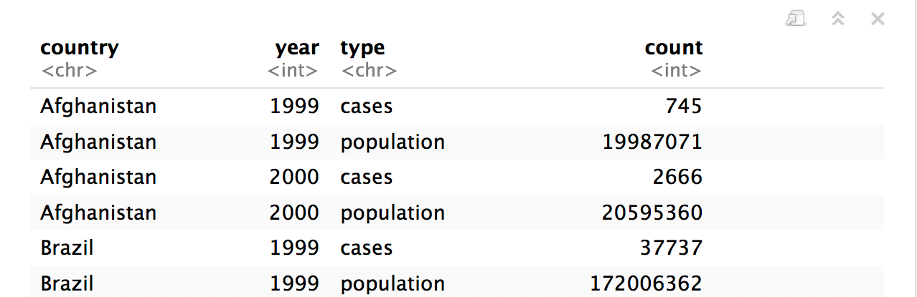
Your Turn 4
Use pivot_wider() to reorganize table2 into four columns: country, year, cases, and population.

Slide 67
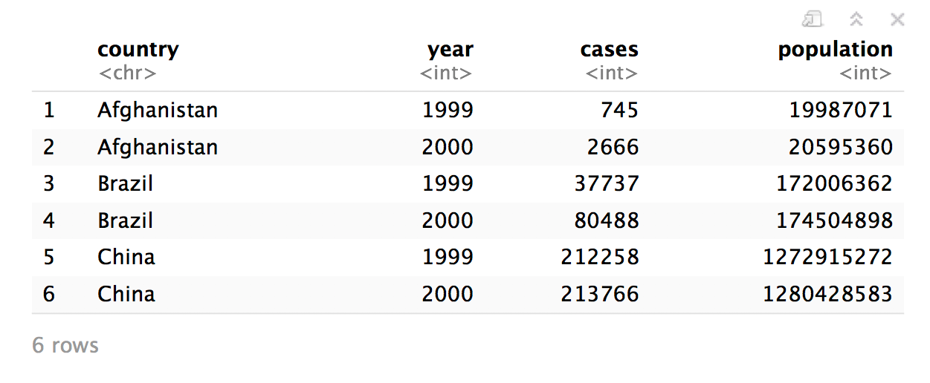
table2 %>%
pivot_wider(names_from = type,
values_from = count)

Slide 68
who
(Untidy Data)

Slide 69
who
Tuberculosis (TB) cases broken down by year, country, age, gender, and diagnosis method from the 2014 World Health Organization Global Tuberculosis Report
View(who)

Slide 70
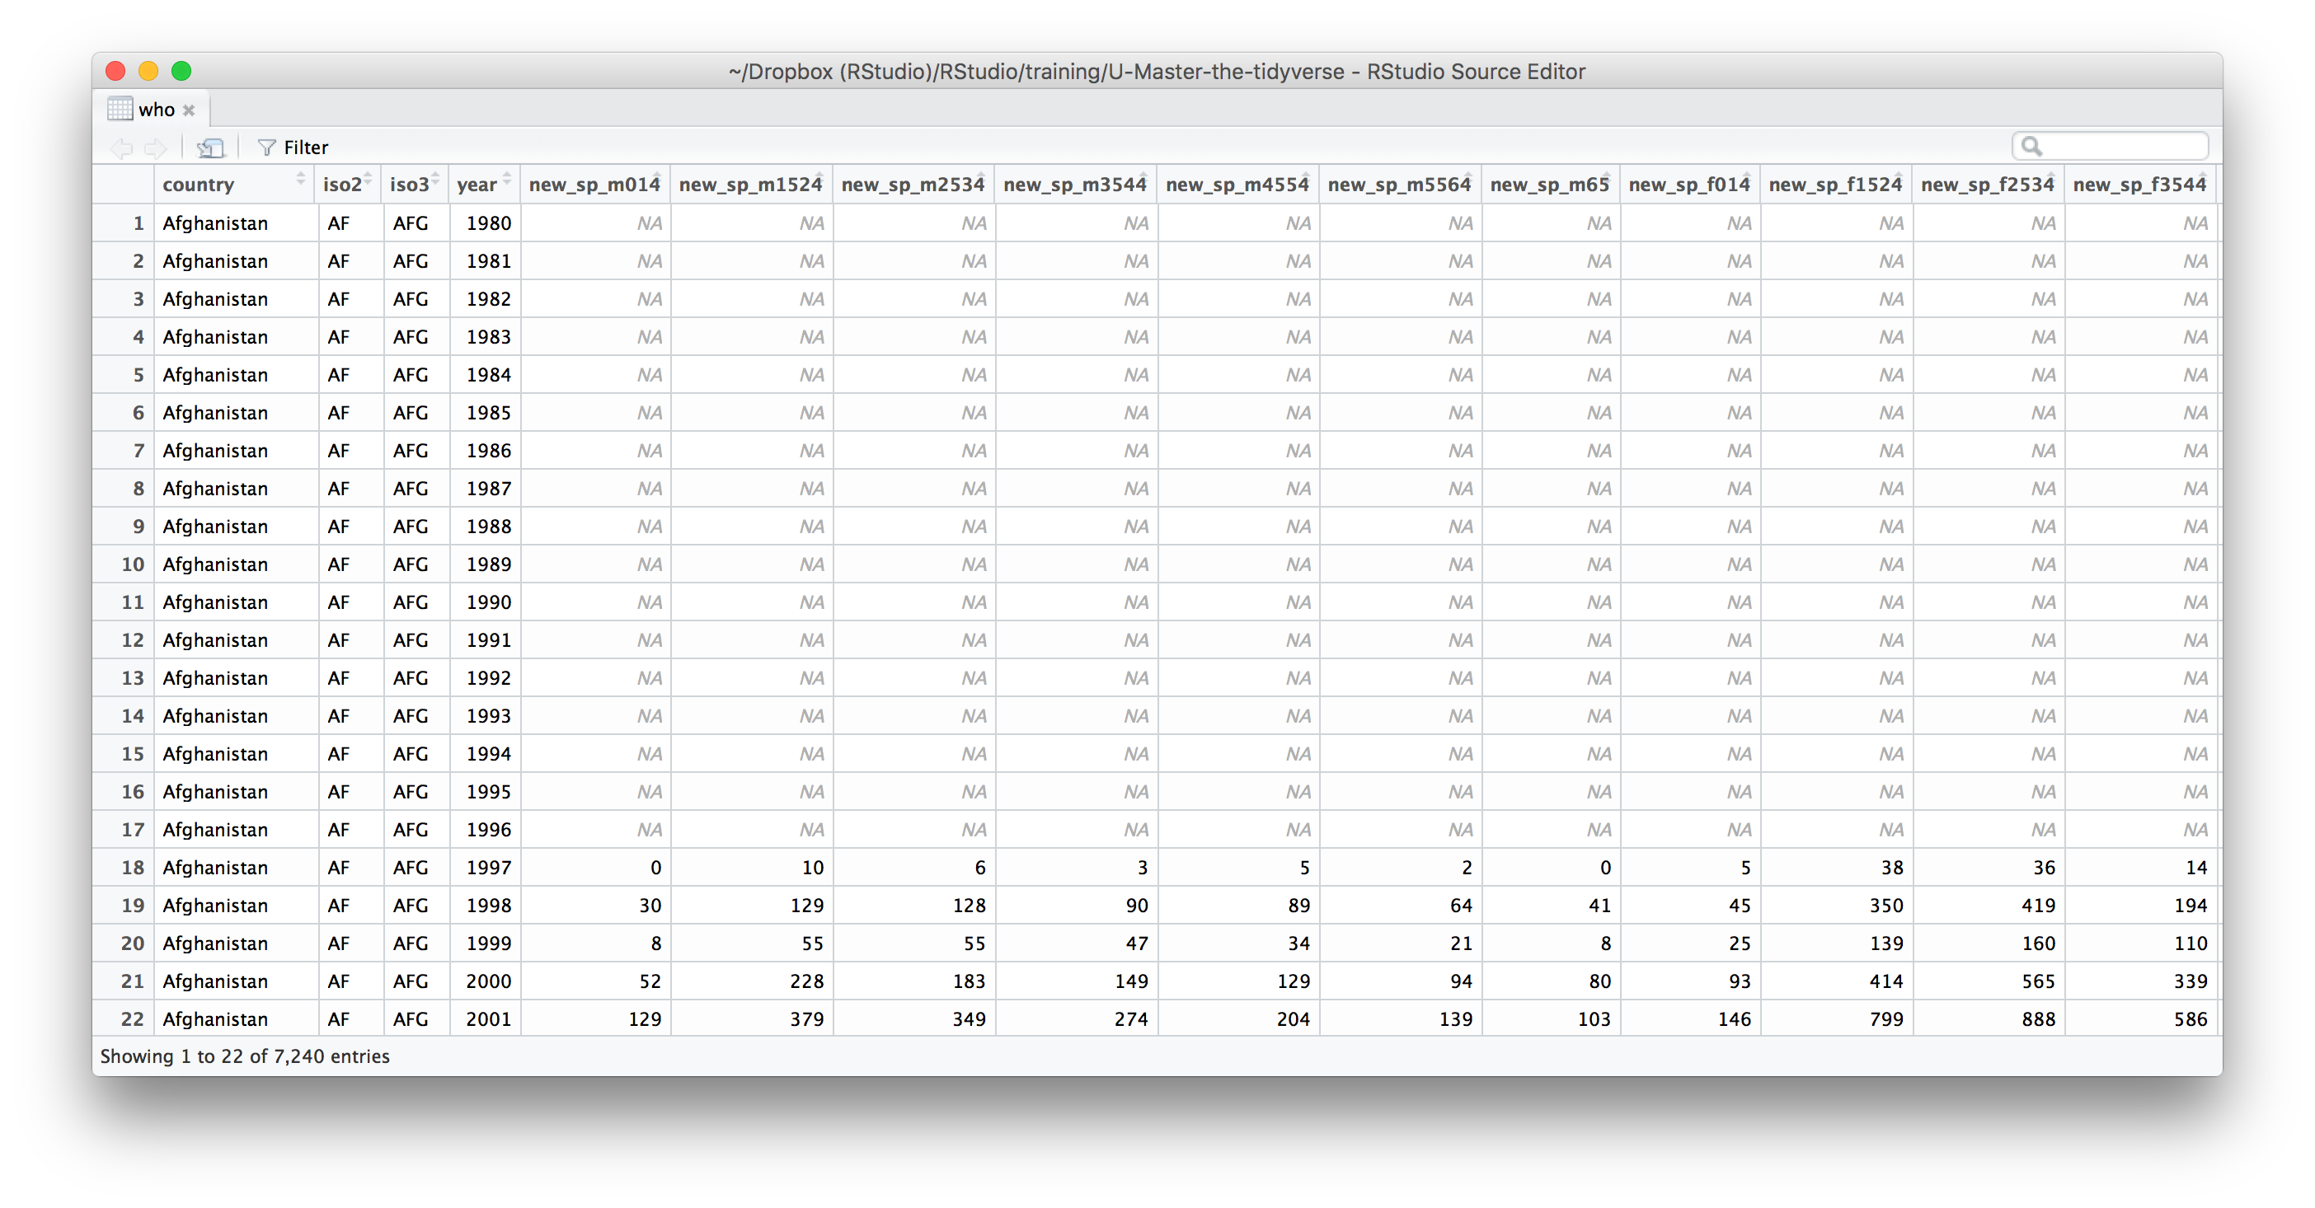
What variables does this data set contain?

Slide 71
who variables
country, iso2, iso3 - country identifiers
year - year
other columns names - encode type of TB case, sex, and age

Slide 72

who codes
Type of TB case
rel - relapse
ep - extra-pulmonary
sn- pulmonary, smear negative
sp -pulmonary, smear positive
Gender
m - male
f - female
Age group
014 - 0 to 14 years old
1524 - 15 to 24 years old
2534 - 25 to 34 years old
3544 - 35 to 44 years old
4554 - 45 to 54 years old
5564 - 55 to 64 years old
65 - 65 and older

Slide 74
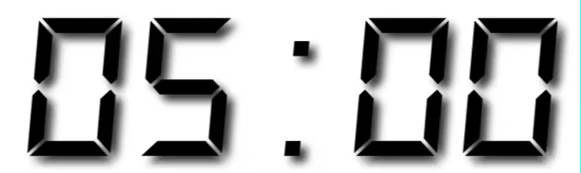
Your Turn 5
Pivot the 5th through 60th columns of who into a pair of columns containing the column names in codes and values in n.
Then select just the county, year, codes and n variables.

Slide 75
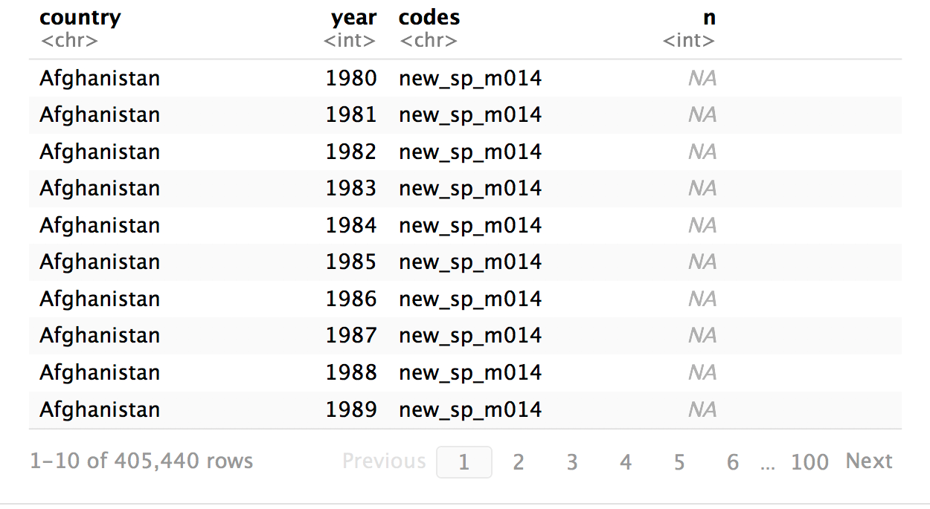
who %>%
pivot_longer(cols = 5:60, names_to="codes", values_to="n") %>%
select(-iso2, -iso3)

Slide 76
separate()

Slide 77
separate()
Splits a column by dividing values at a specific character.
who %>%
pivot_longer(cols = 5:60, names_to="codes", values_to="n") %>%
select(-iso2, -iso3) %>%
separate(codes, into = c("new", "type", "sexage"), sep = "_")
a column to split
names of new columns to make
string to split on
(Defaults to any non_alpha-numeric character)

Slide 78
separate(storms, date, c("year","month","day"), sep = "-")
storm wind pressure date
1 Alberto 110 1007 2000-08-03
2 Alex 45 1009 1998-07-27
3 Allison 65 1005 1995-06-03
4 Ana 40 1013 1997-06-30
5 Arlene 50 1010 1999-06-11
6 Arthur 45 1010 1996-06-17
storm wind pressure year month day
1 Alberto 110 1007 2000 08 03
2 Alex 45 1009 1998 07 27
3 Allison 65 1005 1995 06 03
4 Ana 40 1013 1997 06 30
5 Arlene 50 1010 1999 06 11
6 Arthur 45 1010 1996 06 17

Slide 79
separate(storms, date, c("year","month","day"), sep = "-")
storm wind pressure date
1 Alberto 110 1007 2000-08-03
2 Alex 45 1009 1998-07-27
3 Allison 65 1005 1995-06-03
4 Ana 40 1013 1997-06-30
5 Arlene 50 1010 1999-06-11
6 Arthur 45 1010 1996-06-17
storm wind pressure year month day
1 Alberto 110 1007 "2000" "08" "03"
2 Alex 45 1009 "1998" "07" "27"
3 Allison 65 1005 "1995" "06" "03"
4 Ana 40 1013 "1997" "06" "30"
5 Arlene 50 1010 "1999" "06" "11"
6 Arthur 45 1010 "1996" "06" "17"

Slide 80
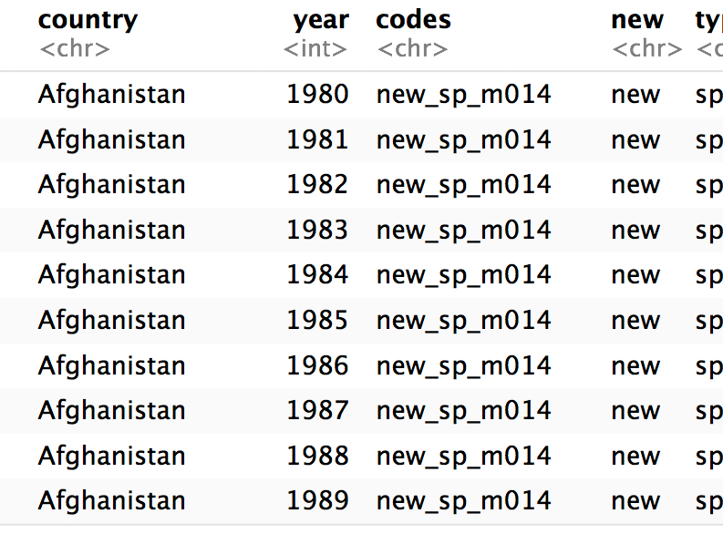
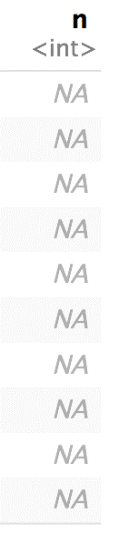
who %>%
pivot_longer(cols = 5:60, names_to="codes", values_to="n") %>%
select(-iso2, -iso3) %>%
separate(
)

Slide 81

who %>%
pivot_longer(cols = 5:60, names_to="codes", values_to="n") %>%
select(-iso2, -iso3) %>%
separate(codes
)

Slide 82
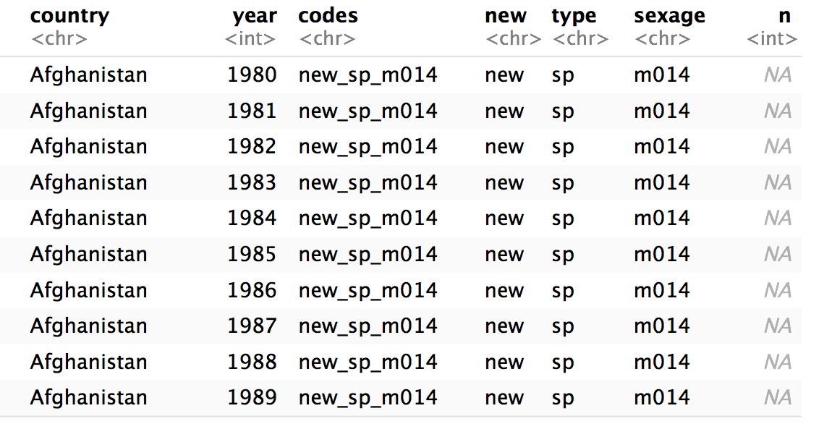
who %>%
pivot_longer(cols = 5:60, names_to="codes", values_to="n") %>%
select(-iso2, -iso3) %>%
separate(codes, into = c("new", "type", "sexage")
)

Slide 83
who %>%
pivot_longer(cols = 5:60, names_to="codes", values_to="n") %>%
select(-iso2, -iso3) %>%
separate(codes, into = c("new", "type", "sexage"), sep = "_")
)

Slide 84
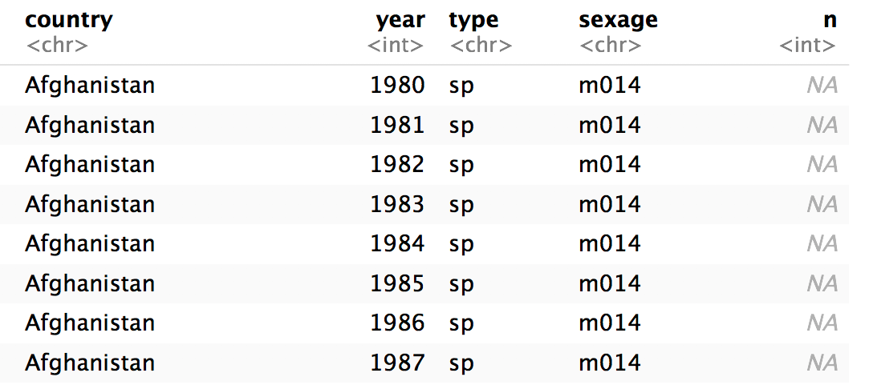
who %>%
pivot_longer(cols = 5:60, names_to="codes", values_to="n") %>%
select(-iso2, -iso3) %>%
separate(codes, c("new", "type", "sexage"), sep = "_") %>%
select(-new)

Slide 85
separate()
Splits a column by dividing values at a specific character.
who %>%
pivot_longer(cols = 5:60, names_to="codes", values_to="n") %>%
select(-iso2, -iso3) %>%
separate(codes, c("new", "type", "sexage"), sep = c(4, 7))
locations to split at
(Split after 4th and 7th characters)

Slide 86
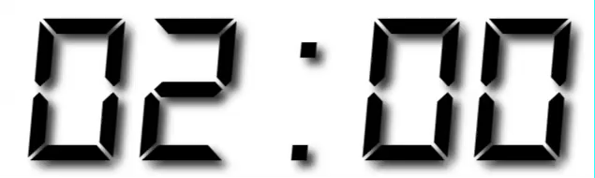
Your Turn 6
Separate the sexage column into sex and age columns.

Slide 87
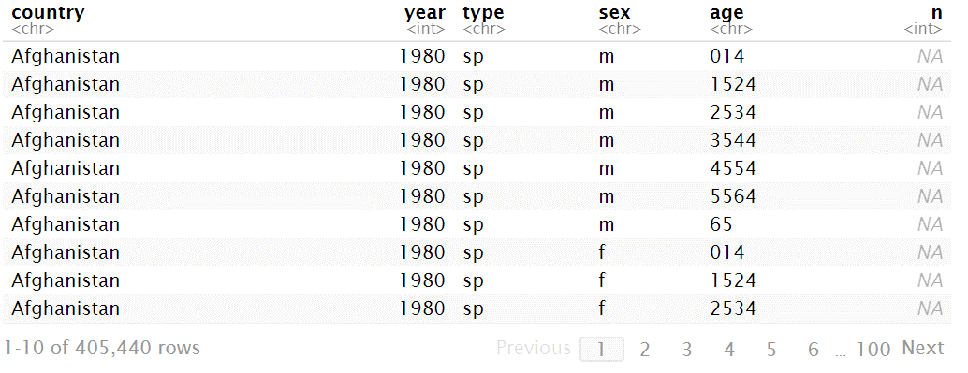
who %>%
pivot_longer(cols = 5:60, names_to="codes", values_to="n") %>%
select(-iso2, -iso3) %>%
separate(codes, c("new", "type", "sexage"), sep = "_") %>%
select(-new) %>%
separate(sexage, into = c("sex", "age"), sep = 1)

Slide 88
unite()

Slide 89
unite()
Unites columns into single column by combining cells.
unite(data, col, …, sep = "")
data frame to reshape
name of new column to make
(in quotes)
two or more columns to combine
separator to place between elements in new column
(Defaults to an underscore)

Slide 90
Missing
Values

Slide 91
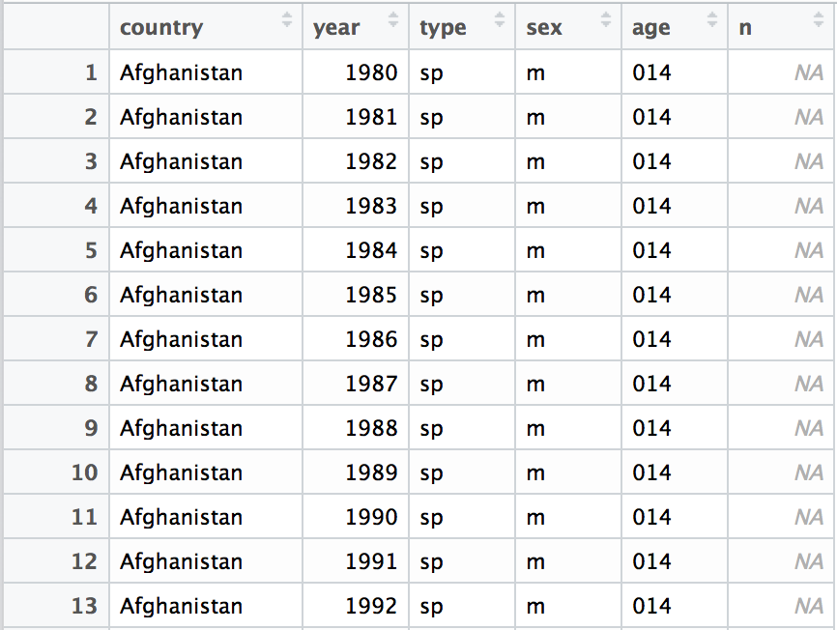
Can we clean up the missing values?

Slide 92
Toy data
x
x <- tribble(
~x1, ~x2,
"A", 1,
"B", NA,
"C", NA,
"D", 3,
"E", NA
)
x1 | x2
A | 1
B | NA
C | NA
D | 3
E | NA

Slide 93
fill()
Fills in NA’s with preceding (or following) values.
fill(x, x2, .direction = "down")
data frame to transform
column(s) with NA’s to replace
"down" fills each NA with the preceding value, "up" with the following value

Slide 94
fill()
Fills in NA’s with preceding (or following) values.
fill(x, x2, .direction = "down")
x
x
x1 | x2
A | 1
B | NA
C | NA
D | 3
E | NA
x1 | x2
A | 1
B | 1
C | 1
D | 3
E | 3

Slide 95
fill()
Fills in NA’s with preceding (or following) values.
fill(x, x2, .direction = "up")
x
x
x1 | x2
A | 1
B | NA
C | NA
D | 3
E | NA
x1 | x2
A | 1
B | 3
C | 3
D | 3
E | NA

Slide 96
replace_na()
Replace NA’s by column.
replace_na(x, replace = list(x2 = 2))
data frame to transform
A named list of column names paired with values to replace NA’s with.

Slide 97
replace_na()
Replace NA’s by column.
replace_na(x, replace = list(x2 = 2))
x
x
x1 | x2
A | 1
B | NA
C | NA
D | 3
E | NA
x1 | x2
A | 1
B | 2
C | 2
D | 3
E | 2

Slide 98
drop_na()
Drops rows that contain NA’s in the specified columns.
drop_na(x, x2)
data frame to transform
column(s) to screen for NA’s

Slide 99
drop_na()
Drops rows that contain NA’s in the specified columns.
drop_na(x, x2)
x
x
x1 | x2
A | 1
B | NA
C | NA
D | 3
E | NA
x1 | x2
A | 1
D | 3

Slide 100
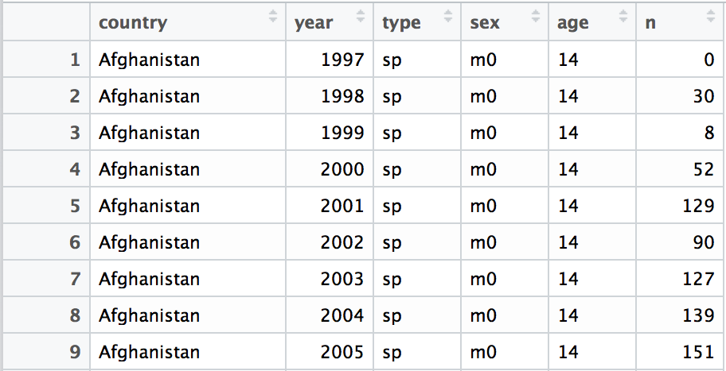
who %>%
pivot_longer(cols = 5:60, names_to="codes", values_to="n") %>%
separate(codes, c("new", "type", "sexage"), sep = "_") %>%
select(-new, -iso2, -iso3) %>%
separate(sexage, c("sex", "age"), sep = 2) %>%
drop_na(n)

Slide 101
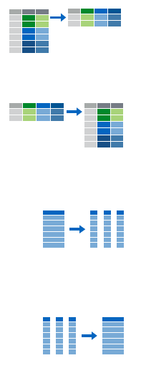
Recap
Move values into column names with spread()
Move column names into values with gather()
Split a column with separate() or separate_rows()
Unite columns with unite()

Slide 103
Reshaping
Check your understanding

Slide 104
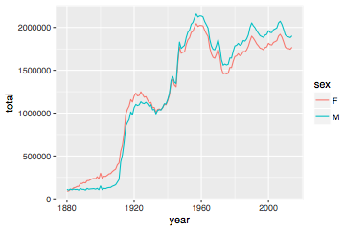
Number of children by year and gender
CC BY-SA RStudio

Slide 105
Can we calculate the ratio of boys to girls?
babynames %>%
group_by(year, sex) %>%
summarise(n = sum(n))
year sex n
<dbl> <chr> <int>
1 1880 F 90993
2 1880 M 110491
3 1881 F 91954
4 1881 M 100745
5 1882 F 107850
6 1882 M 113688
7 1883 F 112321

Slide 106
Can we calculate the ratio of boys to girls?
babynames %>%
group_by(year, sex) %>%
summarise(n = sum(n))
year sex n
<dbl> <chr> <int>
1 1880 F 90993
2 1880 M 110491
3 1881 F 91954
4 1881 M 100745
5 1882 F 107850
6 1882 M 113688
7 1883 F 112321
Now what?

Slide 107
Can we calculate the ratio of boys to girls?
better_layout %>%
mutate(percent_male = M / (M + F) * 100)
year sex n
<dbl> <chr> <int>
1 1880 F 90993
2 1880 M 110491
3 1881 F 91954
4 1881 M 100745
5 1882 F 107850
6 1882 M 113688
7 1883 F 112321
year F M
* <dbl> <int> <int>
1 1880 90993 110491
2 1881 91954 100745
3 1882 107850 113688
4 1883 112321 104629
5 1884 129022 114445
6 1885 133055 107800
7 1886 144535 110784
?

Slide 108
Check your understanding
Reshape the layout of this data. Calculate the percent of male (or female) children by year. Then plot the percent over time.
babynames %>%
group_by(year, sex) %>%
summarise(n = sum(n))

Slide 109
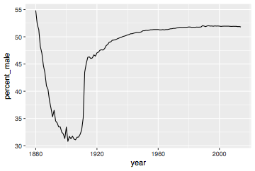
babynames %>%
group_by(year, sex) %>%
summarise(n = sum(n)) %>%
pivot_wider(names_from = sex, values_from = n) %>%
mutate(percent_male = M / (M + F) * 100) %>%
ggplot(aes(year, percent_male)) + geom_line()
CC BY-SA RStudio

Slide 110
Percent of children that are male by year
CC BY-SA RStudio

Slide 111
General advice
Describe what you want to do in an equation. Each variable in the equation should correspond to a variable in your data:
"color by sex"
color = sex
"calculate the proportion of males"
prop male = number of males / number of females + number of males

